Slide 1
RESPIRATION
PRESENTED BY
KAVITA PRAJAPATI

Slide 2
SYNOPSIS:-
INTRODUCATION
DEFINATION
TYPES OF RESPIRATION
MECHANISM OF RESPIRATION
TRANSPORT OF GASES
    OXYGEN TRANPORT
    CARBONDIOXIDE TRANSPORT

Slide 3
CELLULAR RESPIRATION
GLYCOLYSIS
KREB’S CYCLE
ETS
CONCLUSION
REFERENCE :- DR. S.M. SAXSENA

Slide 4
INTRODUCATION:-
The lower respiratory system is a hierarchical system that can be divided into two functional and structural components: the conducting zone and the respiratory zone. The conducting zone consists of airways that transport gases into and out of the lungs and includes the trachea, bronchi, and extends to the terminal bronchioles. The respiratory zone corresponds to the lung parenchyma and includes the respiratory bronchioles, alveolar ducts, alveolar sacs, and alveoli. For the lungs to function properly, the conducting zone must be open to the respiratory zone where gas exchange occurs. Species differences exist in both the gross anatomy and histology of the lower respiratory system and these may compensate for variations in body size and basal metabolic rate.

Slide 5
DEFINATION :-
the physical and chemical processes (such as breathing and diffusion) by which an organism supplies its cells and tissues with the oxygen needed for metabolism and relieves them of the carbon dioxide formed in energy-producing reactions

Slide 6
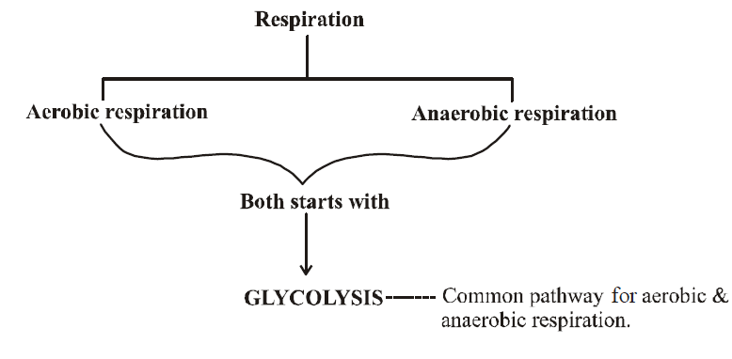
TYPES OF RESPIRATION

Slide 7
MECHANISM OF RESPERATION
The mechanism of respiration involves the following four stages:
Breathing: It is a physical process in which oxygen rich air is taken inside the body (inspiration) and carbon dioxide rich air is forced out of the lungs (expiration).
Gaseous transport: Oxygen absorbed by the blood in the lungs is transported by Red Blood Cells (RBCs) as oxyhaemoglobin throughout the body by means of arteries. Carbon dioxide from the tissues is transported to the lungs by the blood via veins in two ways:
  As bicarbonates dissolved in plasma
  In combination with haemoglobin of RBCs as carbamino-haemoglobin
Tissue respiration: The terminal blood vessels or the capillaries transport oxygen to the body cells or tissues, where oxygen diffuses through their thin walls. Likewise, the capillaries pick up carbon dioxide released by them.
Cellular respiration: The complex chemical changes which occur inside the cells to release energy from glucose. Cellular respiration consists of three main stages - glycolysis, Krebs cycle and electron transport.

Slide 8
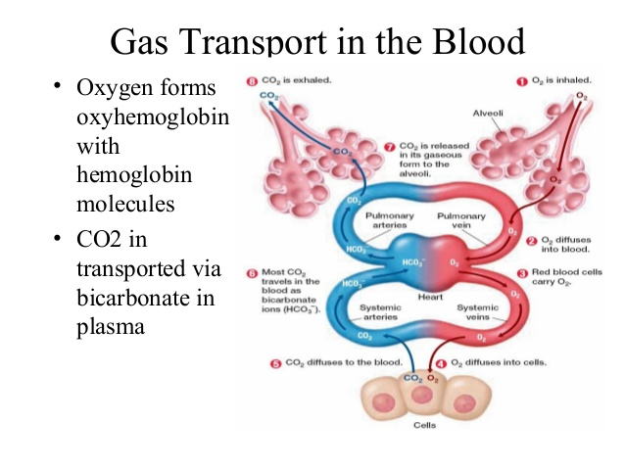
TRANSPORT OF GASES

Slide 9
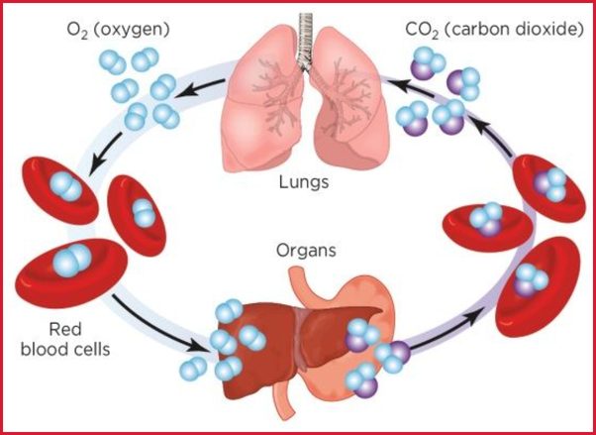

Slide 10
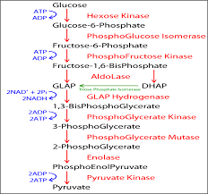
CELLULAE RESPIRATION :- GLYCOLYSIS CYCLE

Slide 11
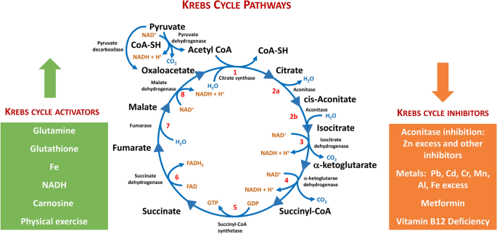
KREB’S CYCLE

Slide 12
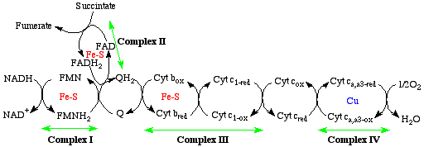
ETS CYCLE

Slide 13
CONCLUSION
As we learn about the human body, it may be easy to reduce the complex and varied functions of the lungs to simply focus on breathing and providing a supply of oxygen. The lungs do indeed perform gas exchange, which relies on differences in partial pressures of gases between the alveoli and the blood. Oxygen is taken up by the blood, while carbon dioxide is released for exhalation. Inhalation and exhalation also require pressure differentials created by anatomical structures such as the chest wall, diaphragm, pleurae, and lungs

