Slide 1
POPULATION
PRESENTED BY
KAVITA PRAJAPATI

Slide 2
INTRODUCTION
DEFINATION
CHARACTERS OF POPULATION
POPULATION DENSITY
BIRTH RATE
DEATH RATE
BIOTIC POTENTIAL
GROWTH PATTERN
POPULATION DISTRIBUTION

Slide 3
FACTOR EFFECTING POPULATION
CONCLUSION
REFERANCE :-DR.S.M.SAXSENA
DR.P.K.DHAKA
IN BHOPAL

Slide 4
INTRODUCTION
A population is defined as a group of individuals of the same species living and interbreeding within a given area. Members of a population often rely on the same resources, are subject to similar environmental constraints, and depend on the availability of other members to persist over time. Scientists study a population by examining how individuals in that population interact with each other and how the population as a whole interacts with its environment. As a tool for objectively studying populations, population ecologists rely on a series of statistical measures, known as demographic parameters, to describe that population. The field of science interested in collecting and analyzing these numbers is termed population demographics, also known as demography.
Broadly defined, demography is the study of the characteristics of populations. It provides a mathematical description of how those characteristics change over time. Demographics can include any statistical factors that influence population growth or decline, but several parameters are particularly important: population size, density, age structure, fecundity (birth rates), mortality (death rates), and sex ratio (Dodge 2006). We introduce each of these in turn.

Slide 5
DEFINATION
the total number of persons inhabiting a country, city, or any district or area.
the assemblage of a specific type of organism living in a given area.
all the individuals of one species in a given area.

Slide 6
CHARACTERS OF POPULATION
1. Population Size and Density:
Total size is generally expressed as the number of indi­viduals in a population.Population density is defined as the numbers of individuals per unit area or per unit volume of environment. Larger organisms as trees may be expressed as 100 trees per hectare, whereas smaller ones like phytoplanktons (as algae) as 1 million cells per cubic metre of water.
In terms of weight it may be 50 kilograms of fish per hectare of water surface. Density may be numerical density (number of individuals per unit area or volume) when the size of individuals in the population is relatively uniform, as mammals, birds or insects or biomass density (biomass per unit area or volume) when the size of individuals is variable such as trees.
Since, the patterns of dispersion of organisms in nature are different population density is also differentiated into crude density and ecological density.

Slide 7
a. Crude density:
It is the density (number or biomass) per unit total space.
b. Ecological density or specific or economic density:
It is the density (number or biomass) per unit of habitat space i.e., available area or volume that can actually be colonized by the population.
2. Population dispersion or spatial distribution:
Dispersion is the spatial pattern of in­dividuals in a population relative to one another. In nature, due to various biotic interactions and influence of abiotic factors, the following three basic population distributions can be observed:
(a) Regular dispersion:
Here the individuals are more or less spaced at equal distance from one another. This is rare in nature but in common is cropland. Animals with territorial behaviour tend towards this dispersion.

Slide 8
(b) Random dispersion:
Here the position of one individual is unrelated to the positions of its neighbours. This is also relatively rare in nature.
(c) Clumped dispersion:
Most populations exhibit this dispersion to some extent, with individuals aggregated into patches interspersed with no or few individuals. Such aggregations may result from social aggregations, such as family groups or may be due to certain patches of the environment being more favourable for the population concerned.
3 . Natality (birth rate):
Population increase because of natality. It is simply a broader term covering the production of new individuals by birth, hatching, by fission, etc. The natality rate may be expressed as the number of organisms born per female per unit time. In human population, the natality rate is equivalent to the birth-rate. There are distinguished two types of natality.
(a) Maximum natality:
Also called as absolute or potential or physiological natality, it is the theoretical maximum production of new individuals under ideal conditions which means that there are no ecological limiting factors and that reproduction is limited only by physiological factors. It is a constant for a given population. This is also called fecundity rate.

Slide 9
4.Mortality (death rate):Mortality means the rate of death of individuals in the population. Like natality, mortality may be of following types:
(a) Minimum mortality:
Also called specific or potential mortality, it represents the theo­retical minimum loss under ideal or non-limiting conditions. It is a constant for a population.
(b) Ecological or realised mortality:
It is the actual loss of individuals under a given environmental condition. Ecological mortality is not constant for a population and varies with population and environmental conditions, such as predation, disease and other ecological haz­ards.
5.Biotic potential:-Each population has the inherent power to grow. When the environment is unlimited, the specific growth rate (i.e., the population growth rate per individual) becomes constant and maximum for the existing conditions. The value of the growth rate under these favourable conditions is maximal, is characteristics of a particular population age structure, and is a single index of the inherent power of a population to grow.

Slide 10
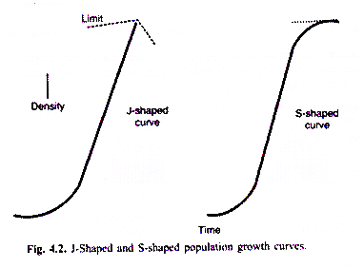
6.Population Growth:
The growth is one of the dynamic features of species population. Population size increases in a characteristic way. When the number of individuals of population is plotted on the y-axis and the times on the x-axis, a curve is obtained that indicates the trend in the growth of population size in a given time. This curve is called population growth curve.

Slide 11
Factor effecting population
There are several factors that affect the population distribution in India:
Geographical Factors
Social Factors
Cultural Factors
Economic Factors

Slide 12
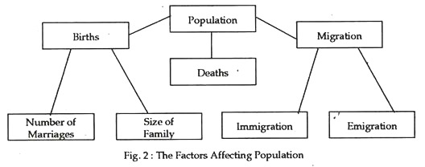

Slide 13
CONCLUSION:-
Rapid population growth is detrimental to achieving economic and social progress and to sustainable management of the natural resource base. But there remains a sizeable gap between the private and social interest in fertility reduction, and this gap needs to be narrowed. Policies and programs that influence health, education, the status of women, and the economic value of children in turn influence attitudes toward chiIdbearing, family planning, and people's ability to control family size. Efforts to reduce fertility through explicit population policies, therefore, should be integrated with policies to improve health, education, and the status of women.

